Slide 1


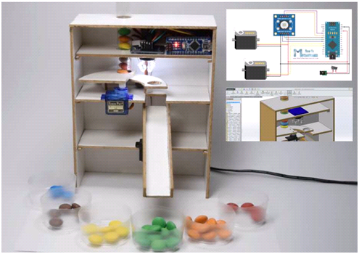
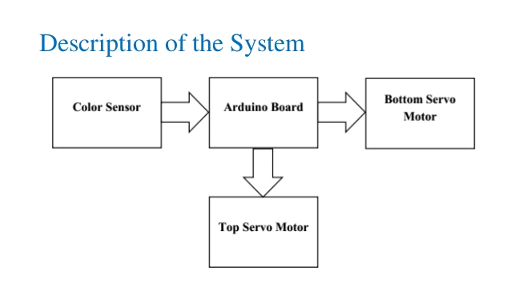
COLOUR SORTER
W.C.K.D
John Smith, MD¹; Jane Doe, PhD²; Frederick Jones, MD, PhD^{1,2}
¹University of Affiliation, ²Medical Center of Affiliation
Abstract
Materials
Arduino color sorter project demonstrate the operations of sorting machines that are commonly used by industries. This project features an Arduino board and a color sensor that able to organize objects based on color. The physical construction is design in 3D application which exactly fits to the operation
Arduino Nano
Colour sensor TCS3200
Servo motors
Foam board
Glue gun
Jumper wires
Breadboard
Gems
Introduction
Results
Conclusion
Physical construction is made of fiberboard cut and glued with respect to the 3D design. The Arduino nano serves as the primary controller in which the components such as color sensor and servo motors are connected. It analysis the data received from color sensor and then transmit a command to the servo motors. The color sensor is attached facing down as it checked the object color and this checking correspond to a color frequency with a custom made function that helps to identify the color of the object. The top servo ensure a piece of object is delivered after the object color is identified, which it moves the object from the source to the color sensor, then to the dropping hole with a slider platform handle by a bottom servo. This slider platform is then set in order to deliver the object to the group container where the colored object store.
The Color sorting machine using Arduino is a fascinating and renowned project for techies, who would like to combine Electronics, Machine Building and Programming. The Color Sorting Machines is used for sorting mainly RGB colors. This Color sorting machine separates different colored objects and classifies them in to respective containers/cups. The Color Sorting machine is fully automated with the help of Arduino UNO
In this project Color sensor detect the color of candy and generate output in this output sensor data transfer to arduino arduino will process those data according to code uploaded in it and command servo to move and sort color candy on basis of there color.
Contact
Reference
W.C.K.D
Email: joshuathomas2000@gmail.com
jonareggie619@gmail.com
syamkchungath10@gmail.com
varunthekkayil443@gmail.com
https://howtomechatronics.com/projects/arduino-color-sorter-project/
https://www.eeweb.com/featured-projects/arduino-color-sorter-project

